Slide 1

Comprehensive Budget and Investment Management system
Monish Mudaliar - 22107027
Chitresh Poojary - 22107010
Siddhesh Patil - 22107119
Chinmay Pawaskar - 22107066
Project Guide
Prof. Avani Nair

Slide 2
Contents
Introduction
Objectives
Scope
Features / Functionality
Project Outcomes
Technology Stack

Slide 3
1. Introduction
In our daily life some time we spend money on useless things and don't realise it. To solve this problem we made the Comprehensive Budget and Investment Management system.
In this user of our system updates his daily expenditure and knows where user is spending their money. From that information they can deduce his/her expenditure.

Slide 4
2. Objectives
To improve the financial planning processes by providing a comprehensive view of budgets, expenditures, and revenue projections.
To optimize resource allocation by identifying underutilized resources, reallocating funds, and ensuring resources are aligned with strategic goals.
Align financial goals with the user's overall objectives, promoting consistency and coherence in financial decision-making.

Slide 5
3. Scope
Budget Planning and Management:
Creation and management of budgets for various departments, projects, and initiatives.
2. Analysis:
Scenario analysis to assess the potential impact of different financial decisions.
3. Cost Control and Reduction:
Monitoring and control of costs to prevent overspending and identify cost-saving opportunities.

Slide 6
4. Feature /Functionality
Create Goals:
Users can create Monthly goal to work toward their savings and keep track of progress.
2. Visualization:
Gives pictorial representation of expenditure.
3. Categorization of Funds:
Funds can be categorized based on users preferences.
4. Export Budget :
Created Budget can be exported by printing it as a PDF file.

Slide 7
5. Outcome of Project
Efficient Budget Management: The CBIMS should streamline the budgeting process, resulting in more efficient budget creation, approval, and monitoring.
Optimized Resource Allocation: Improved resource allocation, ensuring that financial resources are allocated to projects, departments, or initiatives in a way that aligns with strategic goals.
Effective Cost Control: Enhanced cost control measures, reducing overspending and identifying cost-saving opportunities.

Slide 8
6. Technology Stack
Java Swing used to create GUI.
SQL used for database.
Java used for backend to communicate with database.

Slide 9
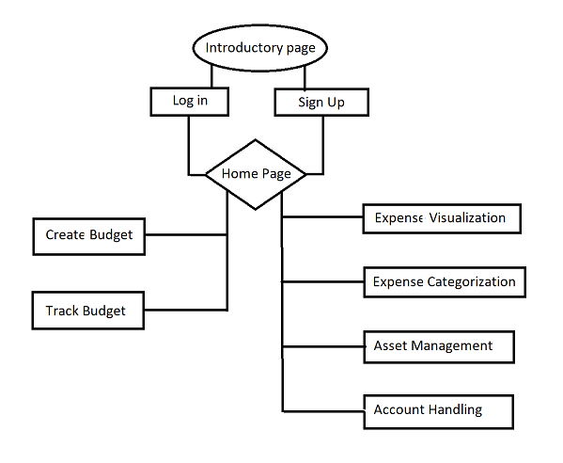
7. BLOCK DIAGRAM:

Slide 10
Thank You...!!

